Slide 1
Chapter 24
Project Scheduling and Tracking
Software Engineering: A Practitioner’s Approach, 6th edition
by Roger S. Pressman

Slide 2
Why Are Projects Late?
an unrealistic deadline established by someone outside the software development group
changing customer requirements that are not reflected in schedule changes;
an honest underestimate of the amount of effort and/or the number of resources that will be required to do the job;
predictable and/or unpredictable risks that were not considered when the project commenced;
technical difficulties that could not have been foreseen in advance;
human difficulties that could not have been foreseen in advance;
miscommunication among project staff that results in delays;
a failure by project management to recognize that the project is falling behind schedule and a lack of action to correct the problem

Slide 3
How to Change an Unrealistic Deadline
Perform a detailed estimate of effort and time using historical data
Using an incremental process model, develop a strategy to deliver critical functionality by the deadline – document the plan
Meet with the customer and explain why the
Offer the incremental development strategy as an alternative
Notes:
imposed deadline is unrealistic by showing data

Slide 4
Scheduling Principles
compartmentalization—define distinct tasks
interdependency—indicate task interrelationship
effort validation—be sure resources are available
defined responsibilities—people must be assigned
defined outcomes—each task must have an output
defined milestones—review for quality

Slide 5
Defining Task Sets
determine type of project
  concept development, new application development, application enhancement, application maintenance, and reengineering projects
assess the degree of rigor required
identify adaptation criteria
select appropriate software engineering tasks

Slide 6
Task Set Refinement
1.1 Concept scoping determines the overall scope of the project.
Task definition: Task 1.1 Concept Scoping
1.1.1 Identify need, benefits and potential customers;
1.1.2 Define desired output/control and input events that drive the application;
Begin Task 1.1.2
1.1.2.1 FTR: Review written description of need
  FTR indicates that a formal technical review (Chapter 26) is to be conducted.
1.1.2.2 Derive a list of customer visible outputs/inputs
1.1.2.3 FTR: Review outputs/inputs with customer and revise as required;
endtask Task 1.1.2
1.1.3 Define the functionality/behavior for each major function;
Begin Task 1.1.3
1.1.3.1 FTR: Review output and input data objects derived in task 1.1.2;
1.1.3.2 Derive a model of functions/behaviors;
1.1.3.3 FTR: Review functions/behaviors with customer and revise as required;
endtask Task 1.1.3
1.1.4 Isolate those elements of the technology to be implemented in software;
1.1.5 Research availability of existing software;
1.1.6 Define technical feasibility;
1.1.7 Make quick estimate of size;
1.1.8 Create a Scope Definition;
endTask definition: Task 1.1
is refined to

Slide 7
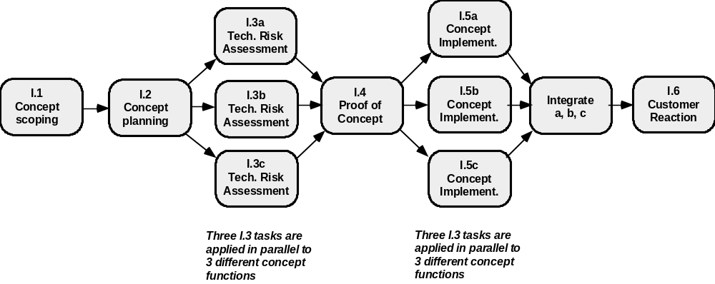
Define a Task Network

Slide 8
Timeline Charts
Tasks
Week 1
Week 2
Week 3
Week 4
Week n
Task 1
Task 2
Task 3
Task 4
Task 5
Task 6
Task 7
Task 8
Task 9
Task 10
Task 11
Task 12

Slide 9
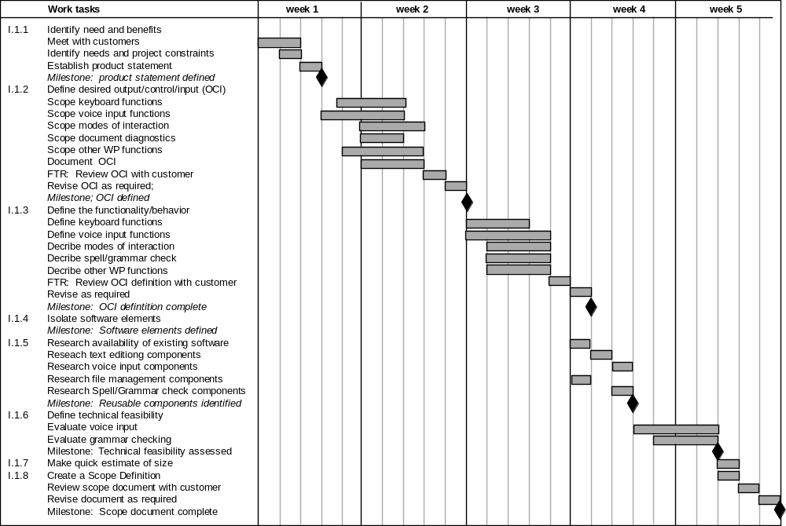
Use Automated Tools to
Derive a Timeline Chart

Slide 10
Schedule Tracking
  conduct periodic project status meetings in which each team member reports progress and problems.
  evaluate the results of all reviews conducted throughout the software engineering process.
  determine whether formal project milestones (diamonds in previous slide) have been accomplished by the scheduled date.
  compare actual start-date to planned start-date for each project task listed in the resource table
  meet informally with practitioners to obtain their subjective assessment of progress to date and problems on the horizon.
  use earned value analysis to assess progress quantitatively.

Slide 11
Earned Value Analysis (EVA)
Earned value
  is a measure of progress
  enables us to assess the “percent of completeness” of a project using quantitative analysis rather than rely on a gut feeling
  “provides accurate and reliable readings of performance from as early as 15 percent into the project.” [FLE98]

Slide 12
Computing Earned Value-I
The budgeted cost of work scheduled (BCWS) is determined for each work task represented in the schedule.
  BCWS_{i} is the effort planned for work task i.
  To determine progress at a given point along the project schedule, the value of BCWS is the sum of the BCWS_{i} values for all work tasks that should have been completed by that point in time on the project schedule.
The BCWS values for all work tasks are summed to derive the budget at completion, BAC. Hence,
BAC = ∑ (BCWS_{k}) for all tasks k

Slide 13


Computing Earned Value-II
Next, the value for budgeted cost of work performed (BCWP) is computed.
  The value for BCWP is the sum of the BCWS values for all work tasks that have actually been completed by a point in time on the project schedule.
“the distinction between the BCWS and the BCWP is that the former represents the budget of the activities that were planned to be completed and the latter represents the budget of the activities that actually were completed.” [WIL99]
Given values for BCWS, BAC, and BCWP, important progress indicators can be computed:
    Schedule performance index, SPI = BCWP/BCWS
    Schedule variance, SV = BCWP – BCWS
    SPI is an indication of the efficiency with which the project is utilizing scheduled resources.

Slide 14
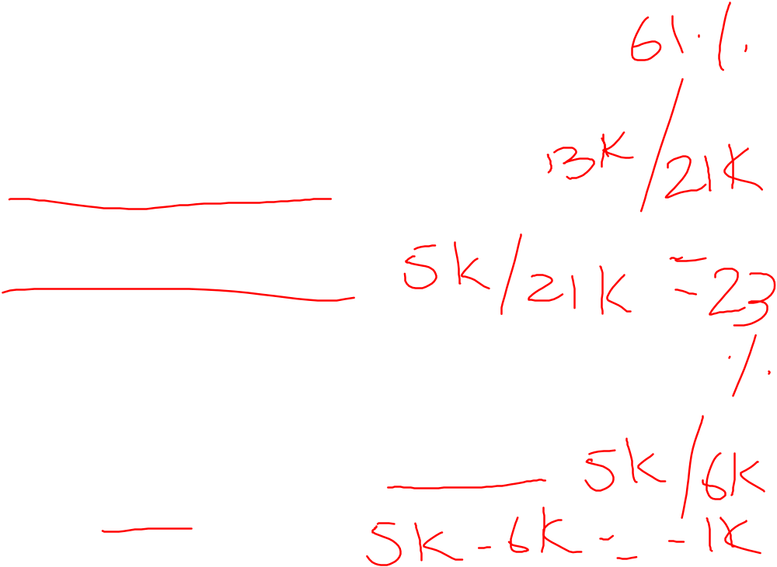
Computing Earned Value-III
Percent scheduled for completion = BCWS/BAC
  provides an indication of the percentage of work that should have been completed by time t.
Percent complete = BCWP/BAC
  provides a quantitative indication of the percent of completeness of the project at a given point in time, t.
Actual cost of work performed, ACWP, is the sum of the effort actually expended on work tasks that have been completed by a point in time on the project schedule. It is then possible to compute
    Cost performance index, CPI = BCWP/ACWP
    Cost variance, CV = BCWP – ACWP

Slide 15
Problem 24.12
Assume you are a software project manager and that you’ve been asked to computer earned value statistics for a small software project. The project has 56 planned work tasks that are estimated to require 582 person-days to complete. At the time that you’ve been asked to do the earned value analysis, 12 tasks have been completed. However, the project schedule indicates that 15 tasks should have been completed. The following scheduling data (in person-days) are available:

Slide 16
Task Planned Effort Actual Effort
1 12 12.5
2 15 11
3 13 17
4 8 9.5
5 9.5 9.0
6 18 19
7 10 10
8 4 4.5
9 12 10
10 6 6.5
11 5 4
12 14 14.5
13 16
14 6
15 8
Compute the SPI, schedule variance, percent scheduled for completion, percent complete, CPI, and cost variance for the project.

